Slide 1
CLASS 6 – 11.30.2021
Player Analytics III – Basketball Analytics
Final – Due Dec.11 | Group
Guest Speaker:
Kevin Tenenbaum
Assistant Director, Baseball Research and Development
Cleveland Guardians
5:00pm: Kevin Tenenbaum
5:30pm: Break (5 mins)
6:05pm: Break (10 mins)

Slide 2

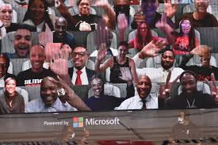

Last year at this time….

Slide 3
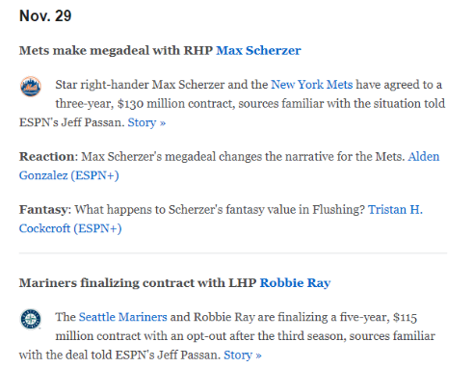
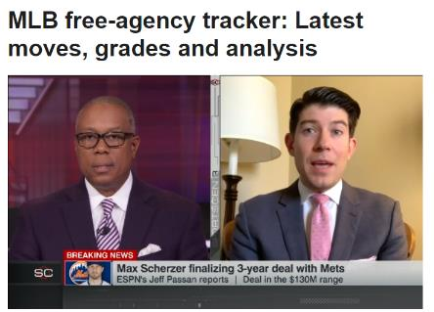
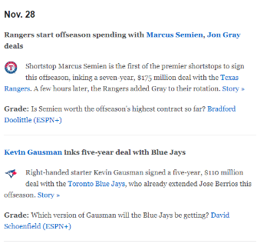
This year – trends from the past week
Late free agency signings & $ raises
Scherzer 5.4 WAR $35.4M $43M*
Ray 3.9 WAR $8.0M $27M
Semien 6.6 WAR $18.0M $25M
Gausman 4.8 WAR $18.9M $24M
* Prev high: Gerritt Cole $36M – NYY ‘19
Notes:
https://www.espn.com/mlb/story/_/id/32644225/mlb-free-agency-tracker-latest-moves-grades-analysis

Slide 4
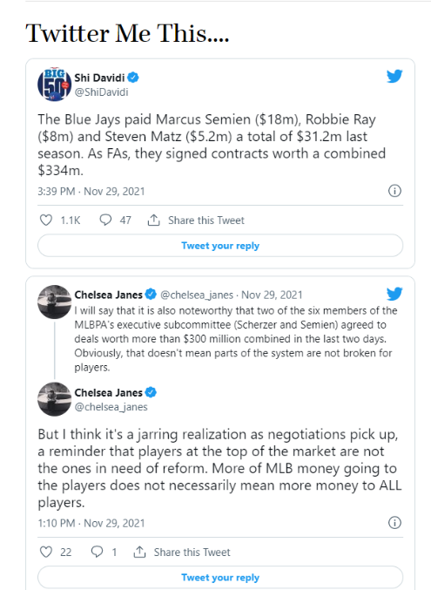

Slide 5
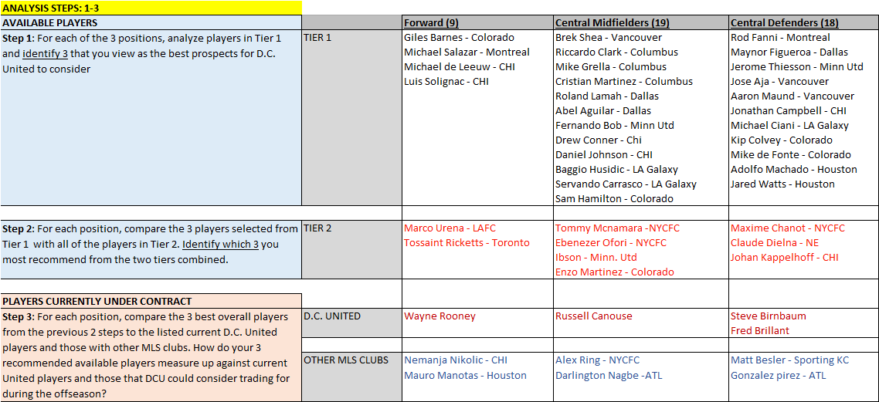
2021 FINAL – DUE 12/11

Slide 6
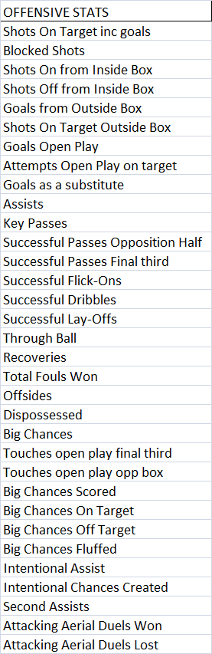
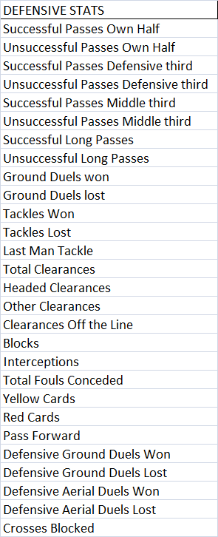
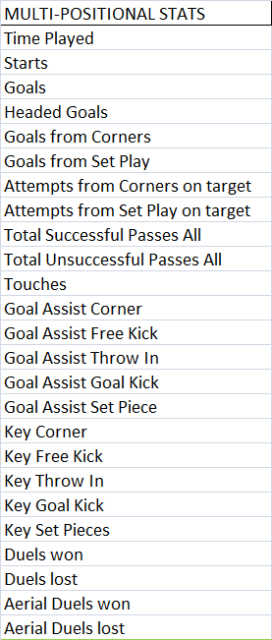
ADVANCED PLAYERS DATA – OPTA – 255 CATEGORIES

Slide 7
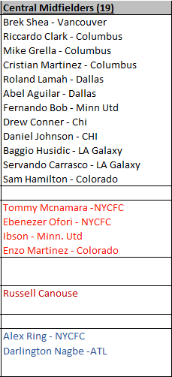
CLASS FINAL – CENTRAL MIDFIELDERS

Slide 8
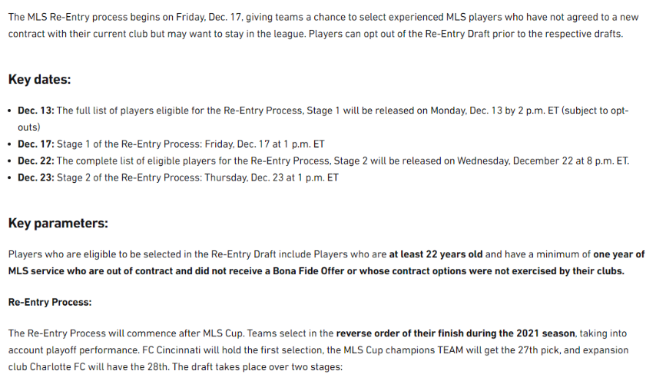
Notes:
https://www.mlssoccer.com/news/2021-mls-re-entry-process-rules-procedures

Slide 9
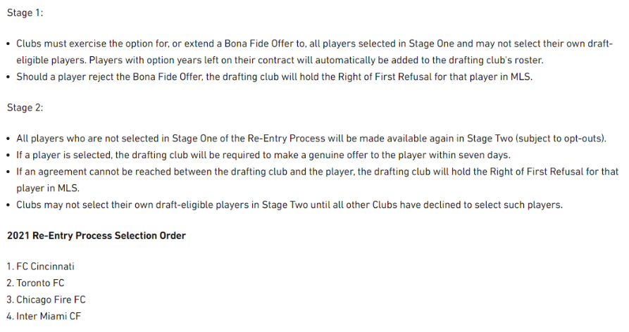
Notes:
https://www.mlssoccer.com/news/2021-mls-re-entry-process-rules-procedures

Slide 10

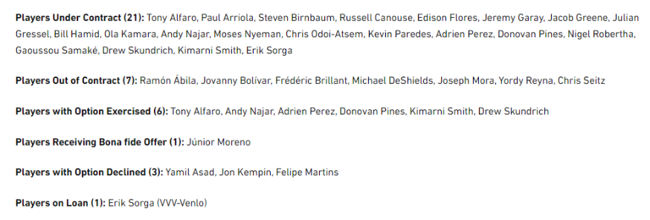

Slide 11
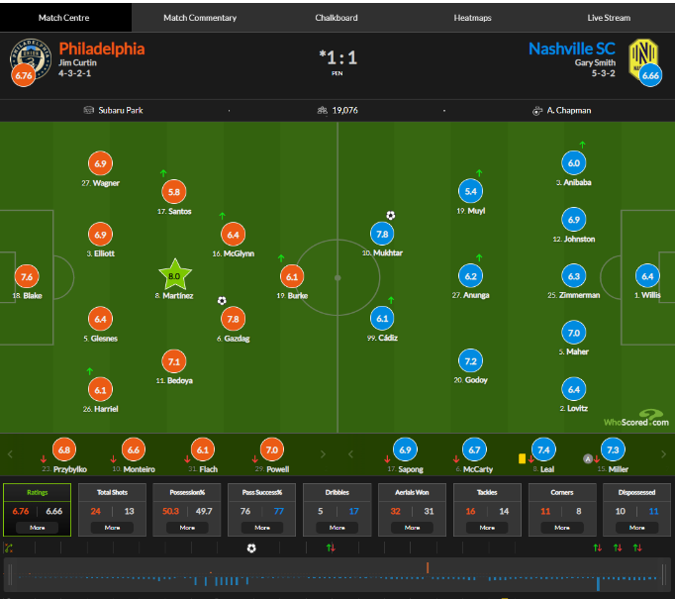
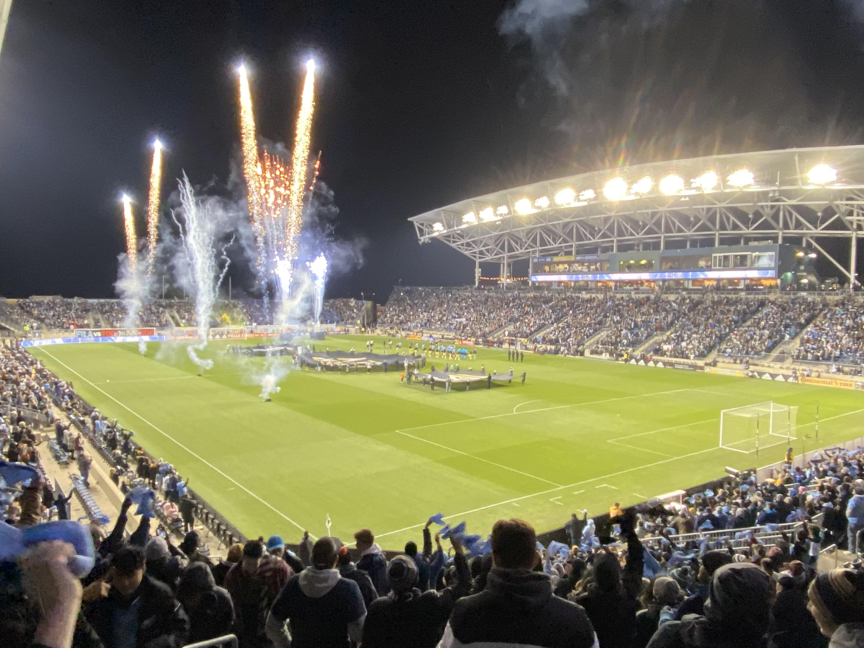
11.28.2021 PHILA UNION 1 | NASHVILLE SC 1 (UNION 2-0 PKs)
https://www.whoscored.com/Matches/1602873/Live/USA-Major-League-Soccer-2021-Philadelphia-Union-Nashville-SC
Notes:
https://www.whoscored.com/Matches/1602873/Live/USA-Major-League-Soccer-2021-Philadelphia-Union-Nashville-SC

Slide 12


Breakout – Match Analysis
Nashville SC-Orlando
Andrew Levy
Cole Beeker
David Goforth
Suyash Shrivastava
Elias Moreno Suarez
Victor Gregory
Josephine Yang
Harshit Aggarwal
Yasir Mohammad
Seattle-RSL
Victoria Abel
Ross Mouritzen
Quentin Alleyne
Daniel Dodson-Castillon
Zaurez Hamid
Akarsh Bychapura Ashok
Lujain Kashgari
Ben Greer
Phila Union-Nashville
Justin Sherman
David Herman
Ignacio Sanchez
Victor Juarez Becerril
Sun Pil Howang
Youssef Ragab
Zachary Zobell
Lawrence Brown
https://www.whoscored.com/Matches/1602049/Live/USA-Major-League-Soccer-2021-Nashville-SC-Orlando-City
https://www.whoscored.com/Matches/1602051/Show/USA-Major-League-Soccer-2021-Seattle-Sounders-FC-Real-Salt-Lake
https://www.whoscored.com/Matches/1602873/Show/USA-Major-League-Soccer-2021-Philadelphia-Union-Nashville-SC
Notes:
https://www.whoscored.com/Matches/1602049/Live/USA-Major-League-Soccer-2021-Nashville-SC-Orlando-City
https://www.whoscored.com/Matches/1602051/Show/USA-Major-League-Soccer-2021-Seattle-Sounders-FC-Real-Salt-Lake
https://www.whoscored.com/Matches/1602873/Show/USA-Major-League-Soccer-2021-Philadelphia-Union-Nashville-SC

Slide 13
Player Analytics
11/16 – Baseball |
11/23 – Soccer | Momin Ghaffar, Jaguars
11/30 – Basketball | Kevin Tenenbaum, Cle MLB
12/7 – Hockey | Oliver Miller-Farrell, Nash SC
KEY TAKEAWAYS:
How has the sport evolved: Basic vs. Advanced Stats
Offense vs. Defense
End-all Be-all | One all encompassing stat? WAR

Slide 14
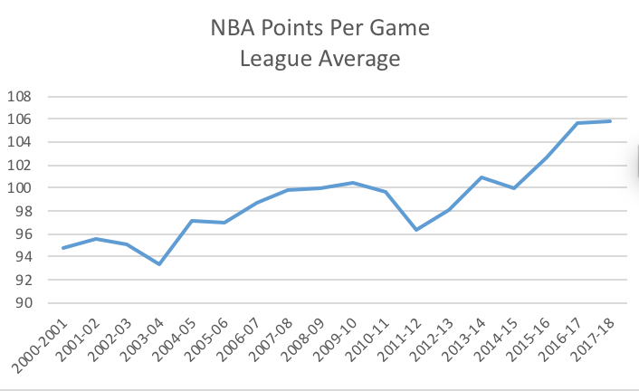
NBA – Scoring on the Rise

Slide 15
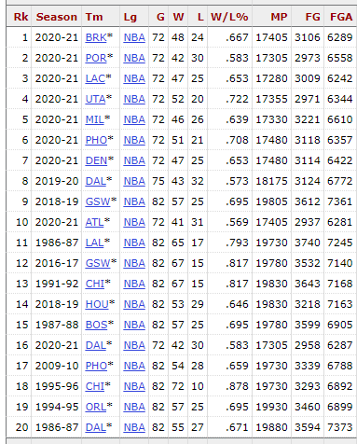
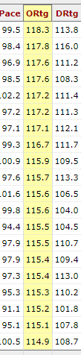
The 2020-21 and 2019-20 seasons were the highest-scoring seasons since the introduction of the three-point line in 1979. When the Milwaukee Bucks averaged 120.1 points last season, they were the first team to reach that benchmark since 1985. Remarkably, the seven most efficient offenses of the three-point era — led by the Brooklyn Nets with a 118.3 offensive rating — took the court last season.
For teams, the formula is: Offensive Team Rating = (Players Points*Total FG%) + Opponents Differential= 1/5 of possessions - Times Fouled+ FTM* FT% * OAPOW( Official Adjusted Players Offensive Withstand .
Notes:
https://stathead.com/tiny/nZzKn

Slide 16
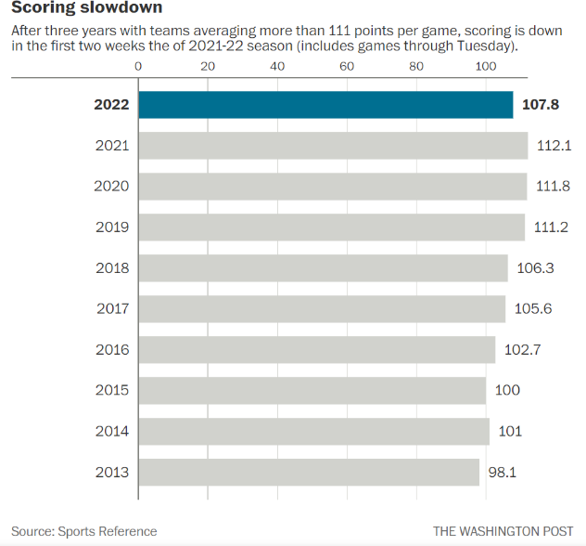
NBA – Scoring slowdown this season

Slide 17
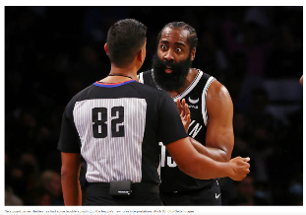
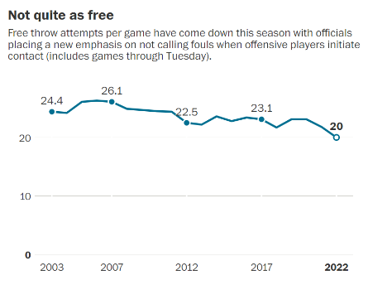
After years of griping from traditionalists and rising complaints from within the league, the NBA’s competition committee enacted a plan this summer to rein in these excesses by cracking down on what it dubbed “non-basketball moves” by offensive players who were hunting free throws rather than making genuine attempts to score. The new framework has had an immediate and dramatic impact in the first two weeks of the 2021-22 season, with free throw attempts plummeting to a record low and teams scoring 4.3 fewer points per game compared with last season after six straight years of increased scoring.
Monty McCutchen, the NBA’s vice president of referee development, and the league’s referees prepared for the new guidelines by reviewing video clips of more than 500 examples of potential “abrupt, overt and abnormal” movement by an offensive player. These plays include launching into a defender after pump-faking, hooking a defender’s arm on a drive, kicking out legs while shooting and abruptly stopping and leaning to initiate a crash with a trailing defender. Instead of being rewarded with free throws as they often were in the past, offensive players guilty of non-basketball moves should now be whistled for offensive fouls if their contact with defenders is deemed “significant.” The referee also can allow play to carry on with no call if the contact is marginal.
Notes:
https://www.washingtonpost.com/sports/2021/11/04/nba-scoring-foul-hunting-free-throws/

Slide 18
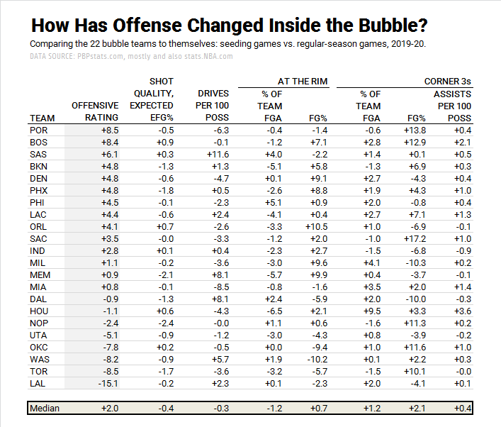
2019-2020: Start of the NBA Bubble vs. Regular Season (8/9/2020)

Slide 19

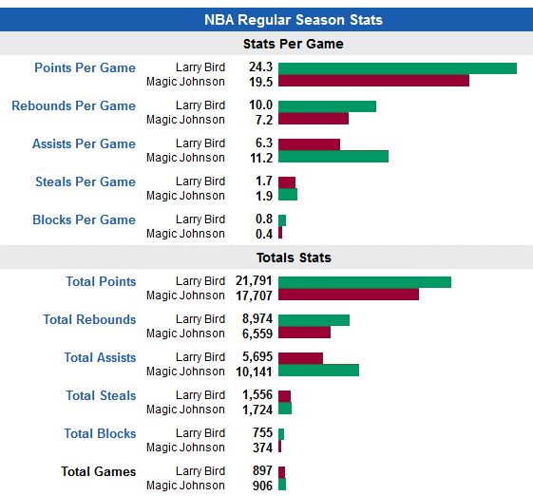
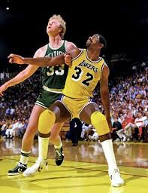
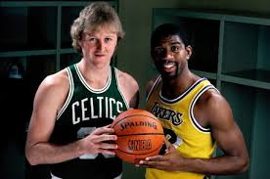
NBA - Old Metrics
Notes:
http://www.landofbasketball.com/player_comparison/b/larry_bird_vs_magic_johnson.htm

Slide 20
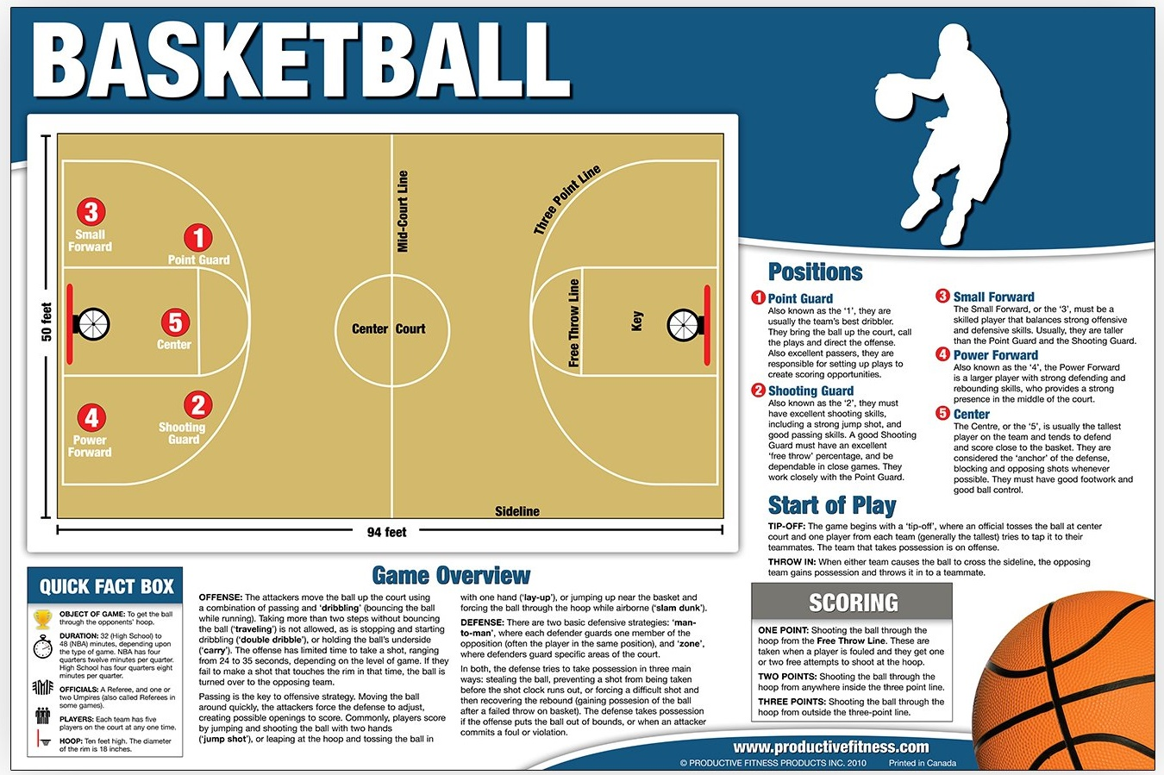

Slide 21
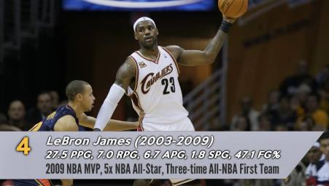
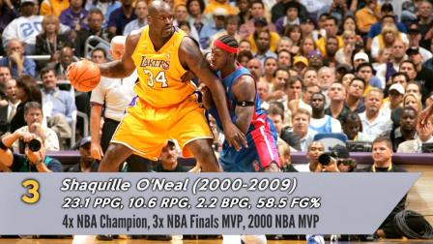
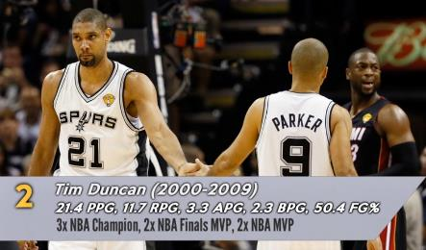
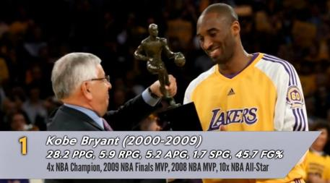
2000s – Top Players/Tradt’l stats
SF/SG
Center
PF/Center
SF/SG

Slide 22
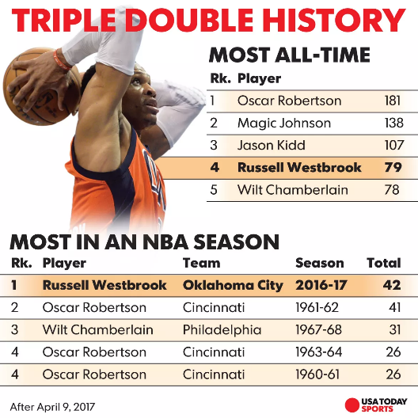
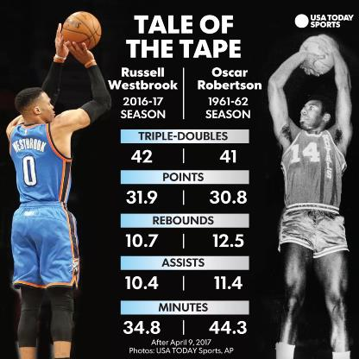
The Triple Double
2016-17: WESTBROOK MAKES HISTORY – TRIPLE DOUBLE
Current: 1.Westbrook 189, 5.James 99, 7.Harden 62, 8.Jokic 59, 11.Doncic 37
Notes:
https://www.basketball-reference.com/leaders/trp_dbl_career.html
https://www.usatoday.com/story/sports/nba/2017/04/09/russell-westbrook-record-42nd-triple-double-oscar-robertson/100261858/
http://www.nytimes.com/2016/11/29/sports/russell-westbrook-nba-triple-double-oklahoma-city-thunder.html?_r=0
Westbrook averaged a triple double for the season, the first player to do so since Robertson (who was the first player in nba history to accomplish that feat)
Westbrook finished the game averaging 31.9 points, 10.7 rebounds and 10.4 assists per contest. He clinched a season-long triple-double average Friday night against the Phoenix Suns. Robertson logged 41 triple-doubles in 1961-62 when he famously became the first player to average one for a season with 30.8 points, 12.5 rebounds and 11.4 assists.

Slide 23
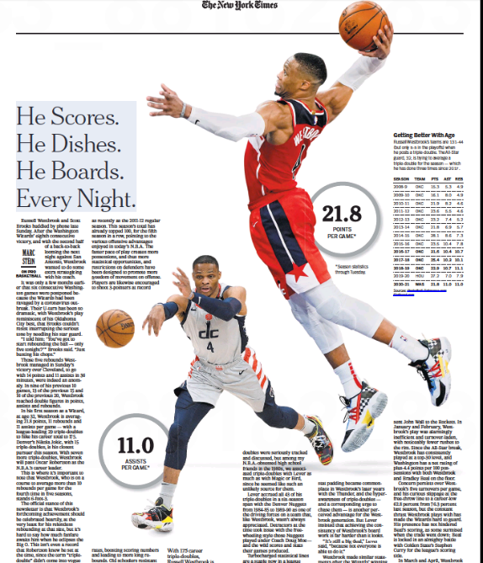
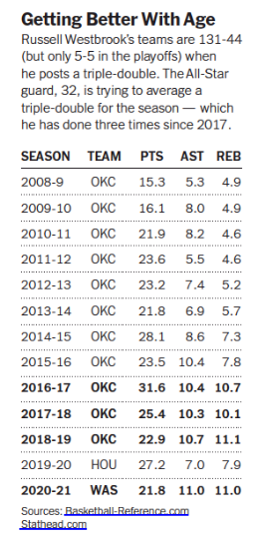
Notes:
https://www.nytimes.com/2021/04/28/sports/basketball/russell-westbrook-triple-double.html

Slide 24
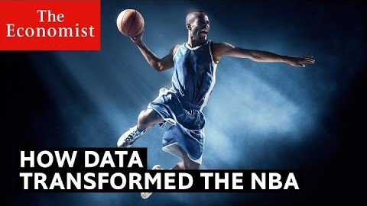
The data transformation – Shoot the “3”
Notes:
Start at :37 and run for 3 mins (3:37)

Slide 25
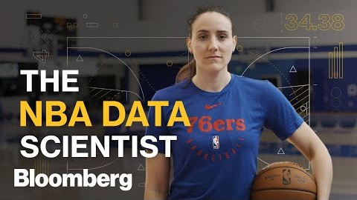
Ivana Seric – 76ers Data Scientist
Notes:
Run for 2-3 mins, thru Pick & Roll. Run from 1:20 to 4:15

Slide 26
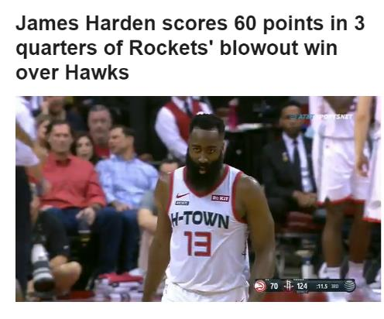
The season of James Harden
11.30.19
Hou 158 | Atl 111
James Harden:
60 pts in 31 minutes
* Shot 16-of-24 from the field, 8-of-14 from 3-point range and 20-of-23 from the free throw line in just 31 minutes. His 24 shot attempts are the fewest ever in a 60-point game in NBA history.
Joined Klay Thompson and Kobe Bryant as the only players in the past 25 seasons to hit 60 points in just three quarters.
Harden's fourth career 60-point game, tying him with Michael Jordan for third most in NBA history, trailing only Kobe Bryant (six) and Wilt Chamberlain (32). Harden is the only active player who has scored 60 points more than once.
Notes:
https://www.espn.com/nba/story/_/id/28198372/james-harden-scores-60-points-3-quarters-rockets-blowout-win-hawks
Highlighting James Harden’s scoring, teeing up for how he will then stack up when advanced analytics are considered

Slide 27
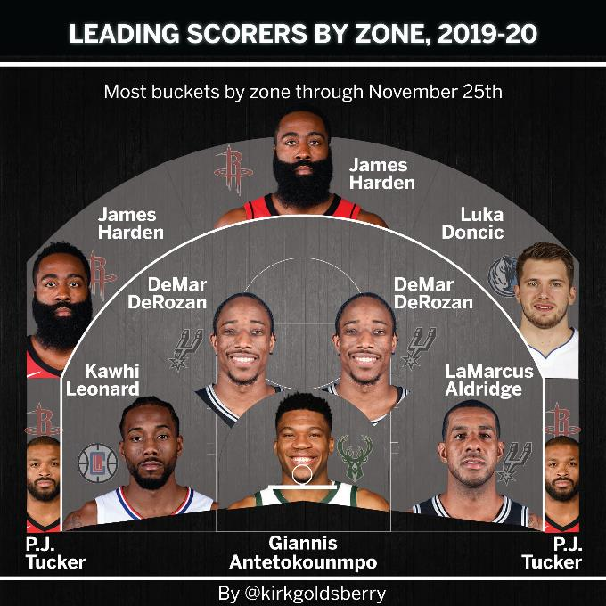
The season of James Harden
Notes:
https://twitter.com/kirkgoldsberry/status/1199362617707397120/photo/1

Slide 28
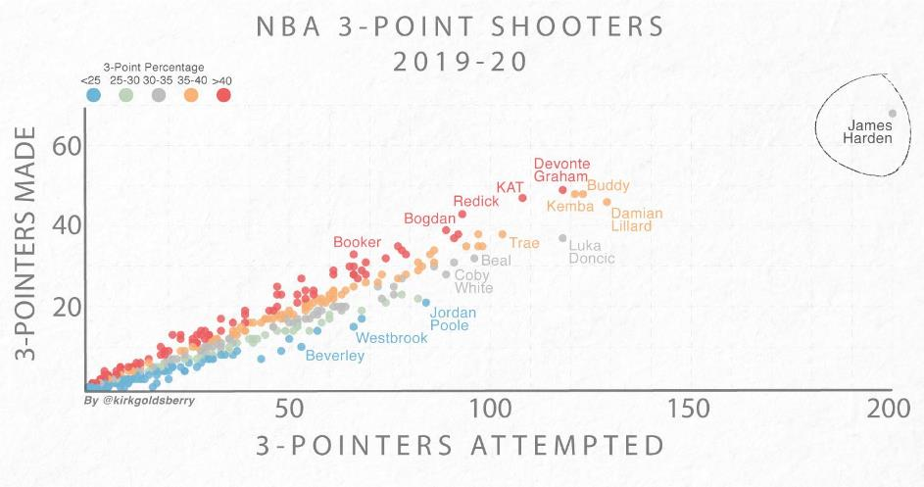
James Harden has attempted 200 3s in his first 14 games
Notes:
https://twitter.com/kirkgoldsberry/status/1197179229697269760/photo/1
James Harden has attempted 200 3s in his first 14 games

Slide 29
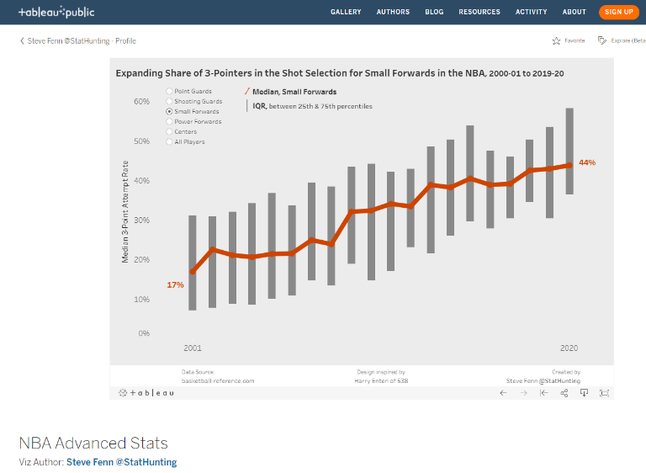
The rise in 3s by position
Notes:
https://public.tableau.com/profile/fennsk#!/vizhome/NBAAdvancedStats_0/DistributionofChosenMetric

Slide 30
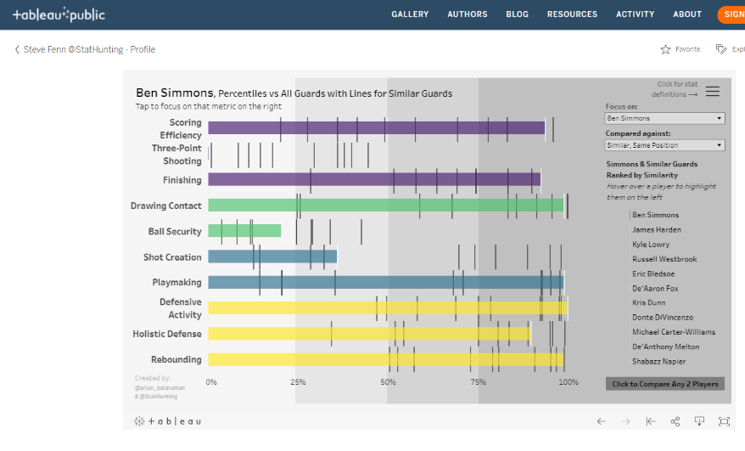
2019-2020: Player comparisons (breakout)
Notes:
https://public.tableau.com/profile/fennsk#!/vizhome/NBAPlayerProfiles_15694132774600/Comparingalongpositionalpercentiles

Slide 31
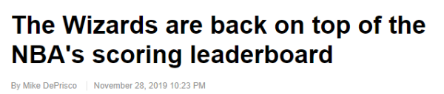
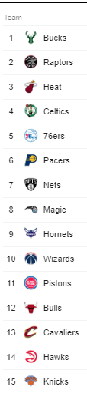
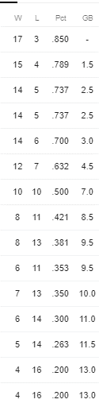
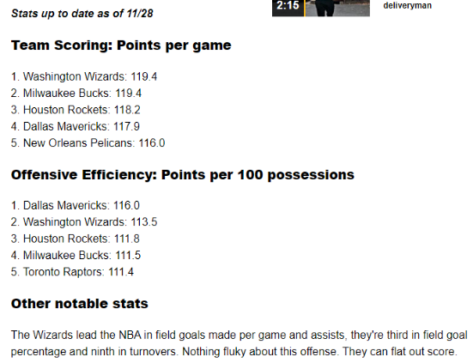
Standings as of 11.28.19
Notes:
https://www.nbcsports.com/washington/wizards/wizards-are-back-top-nbas-scoring-leaderboard

Slide 32
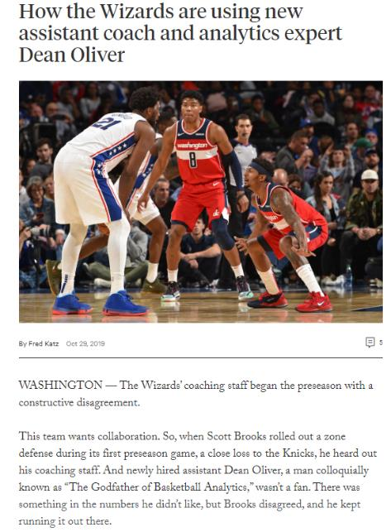
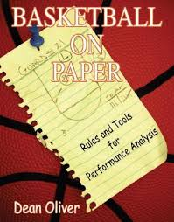
Published – Nov. 2004
Oliver conceptualizes the meaning of teamwork and how to quantify the value of different types of players working together.
Notes:
https://theathletic.com/1332602/2019/10/29/how-the-wizards-are-using-new-assistant-coach-and-analytics-expert-dean-oliver/

Slide 33
NBA - New Metrics
PER (Player Efficiency Rating) – overall production per minute
Player Impact Estimate (PIE) – overall contribution
https://stats.nba.com/help/glossary/
Defensive Rebound Rate (DRR)
Measures the ability of a team/player to rebound on the defensive end
# of defensive rebounds collected/total defensive rebounds available
Adjusted Plus/Minus
Measures effectiveness of a team’s offense and defense with or without or specific player
Points per possession (vs. Points/game)
Notes:
https://stats.nba.com/help/glossary/

Slide 34
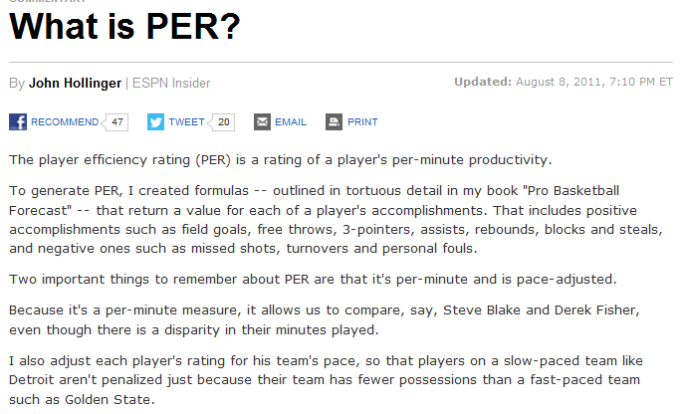
John Hollinger – VP Basketball Ops, Memphis Grizzlies (2013-19)
Now – NBA Columnist, The Athletic (since ’19)
Notes:
http://espn.go.com/nba/columns/story?columnist=hollinger_john&id=2850240

Slide 35
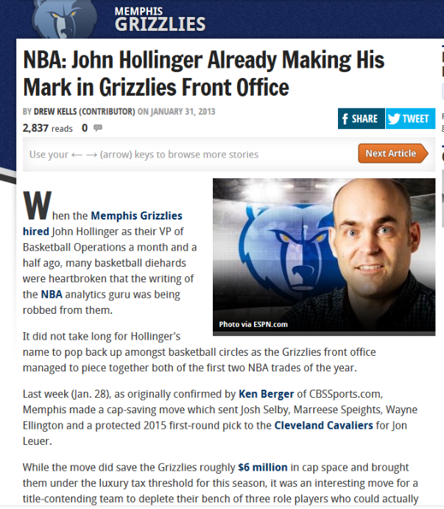
Notes:
http://bleacherreport.com/articles/1509204-nba-john-hollinger-already-making-his-mark-in-grizzlies-front-office
GM until April 2019 - https://www.nba.com/grizzlies/news/memphis-grizzlies-announce-restructuring-of-basketball-operations-department-190411

Slide 36
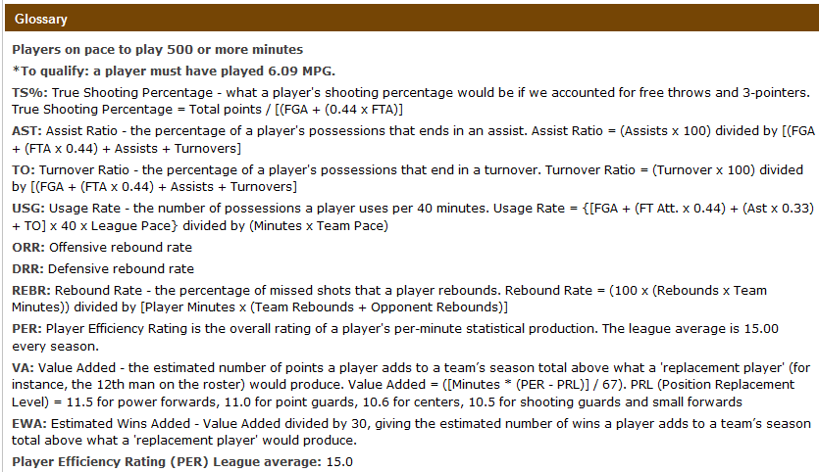
2012-2013 – Hollinger NBA Stats (John Hollinger, ESPN)
Notes:
http://insider.espn.go.com/nba/hollinger/statistics/_/year/2013

Slide 37

PER – Top Players – This Season
NBA Avg: 15.0
Notes:
http://insider.espn.com/nba/hollinger/statistics

Slide 38

PER – Top Players – 2020-2021 Season
NBA Avg: 15.0

Slide 39

2016-2017 NBA Most Improved Player | Bucks first All-Star since ’04
2017-2018: 31.3 points, 10.6 rebounds and 5.1 assists per game in first 8 games of season – first time in NBA history
2019-2020: 2nd in DREB/game (13.6)
5th in scoring: 29.5 pts/game (1. James Harden – 34.3)
https://stats.nba.com/players/traditional/?sort=PTS&dir=-1
https://twitter.com/NBA/status/924010320288288768
Notes:
https://www.nytimes.com/2017/11/03/sports/basketball/giannis-milwaukee-bucks.html
https://twitter.com/NBA/status/924010320288288768
https://stats.nba.com/players/traditional/?sort=PTS&dir=-1

Slide 40


Player Impact Estimate (PIE)
https://on.nba.com/2RbcvLk
Notes:
https://stats.nba.com/help/glossary/
https://stats.nba.com/players/advanced/?sort=PIE&dir=-1&CF=MIN*GE*15 - players with minimum 15 mins/game played on average

Slide 41


Notes:
http://conormclaughlin.net/page/3/

Slide 42



July 5, 2016
Will there be enough minutes to go around? Others smother matters of hierarchy in machismo. Who’s going to be THE MAN?!
http://www.espn.com/nba/story/_/id/18167203/nba-kevin-durant-finding-groove-warriors
Notes:
http://www.si.com/nba/2016/08/05/kevin-durant-stephen-curry-klay-thompson-golden-state-warriors-offense?xid=si_social
http://www.espn.com/nba/story/_/id/18167203/nba-kevin-durant-finding-groove-warriors
https://www.washingtonpost.com/news/sports/wp/2016/07/04/kevin-durant-agrees-to-free-agent-deal-with-golden-state-warriors/?utm_term=.a9081b88e3bb

Slide 43

2015-2016 vs. 2016-2017
POINT GUARD
SMALL FORWARD
POINT GUARD

Slide 44

NBA.com Impact Stats
http://stats.nba.com/impact/
Notes:
http://stats.nba.com/impact/
Have class go to this page and select players. Then select Traditional stats – what stands out. Repeat for Advanced stats

Slide 45



Breakout Activity – Match-ups
http://stats.nba.com/impact/
Lebron James vs. Stephen Curry/Draymond Green {2021-2022}
Andrew Levy
Cole Beeker
David Goforth
Suyash Shrivastava
Elias Moreno Suarez
Victor Gregory
Josephine Yang
Harshit Aggarwal
Yasir Mohammad
Derrick Rose vs. Kevin Durant/James Harden {2020-2021}
Victoria Abel
Ross Mouritzen
Quentin Alleyne
Daniel Dodson-Castillon
Zaurez Hamid
Akarsh Bychapura Ashok
Lujain Kashgari
Ben Greer
Luka Doncic vs. Nikola Jokic {2020-2021}
Justin Sherman
David Herman
Ignacio Sanchez
Victor Juarez Becerril
Sun Pil Howang
Youssef Ragab
Zachary Zobell
Lawrence Brown

Slide 46

* 21 of 30 GMs never played the game (14 of 15 past hires)
"One of my big pushes over the last several years is about making more of this statistical data available to our fans. Because there increasingly seems to be a real hunger by our fans to get deeper into the game and in many ways, we’ve lagged behind other sports, certainly baseball."

Slide 47


Notes:
http://www.sporttechie.com/2013/10/31/sportvu-pulls-nba-analytics-forward/

Slide 48

SportVu Player Tracking Data – NBA.com
http://stats.nba.com/tracking/#!/player/?ls=iref:nba:gnav
Notes:
http://stats.nba.com/tracking/#!/player/?ls=iref:nba:gnav

Slide 49


Notes:
http://stats.nba.com/playerTracking.html

Slide 50

Notes:
http://online.wsj.com/news/articles/SB10001424052702304520704579127281774259324

Slide 51


Slide 52

Hustle Stats – Traditional

Slide 53

Hustle Stats - Advanced
https://stats.nba.com/players/hustle-leaders/
Notes:
https://stats.nba.com/players/hustle-leaders/
Visit the page link and show the different categories. Then go to Contested Twos – click link – led by Antekounpo’s younger brother

Slide 54


Battier has routinely ­guarded the league’s most dangerous offensive players — LeBron James, Chris Paul, Paul Pierce — and has usually managed to render them, if not entirely ineffectual, then a lot less effectual than they normally are. He has done it so quietly that no one really notices what exactly he is up to.
Notes:
http://www.nytimes.com/2009/02/15/magazine/15Battier-t.html?pagewanted=all&_r=1&

Slide 55
Battier vs. Kobe
Personalized scouting report:
Breaks down the floor into many discrete zones with odds of Kobe’s made shots
Kobe’s scoring under different degrees of pressure
Situational: screens, pick-and-rolls, catch-and-shoots
Movement: imbalance between going left or right (Iverson). Kobe less efficient when going left
Goal: Force Kobe to dribble left and pull up for an 18-foot jump shot. Do not foul, do not let him get into the lane.
“My job is not to keep him from scoring points but to make him as inefficient as possible.”
The court doesn’t have little squares all over it to tell him what percentage Bryant is likely to shoot from any given spot, but it might as well.
The effect of doing this is astonishing: Bryant doesn’t merely help his team less when Battier guards him than when someone else does. When Bryant is in the game and Battier is on him, the Lakers’ offense is worse than if the N.B.A.’s best player had taken the night off. “The Lakers’ offense should obviously be better with Kobe in,” Morey says. “But if Shane is on him, it isn’t.” A player whom Morey describes as “a marginal N.B.A. athlete” not only guards one of the greatest — and smartest — offensive threats ever to play the game. He renders him a detriment to his team.

Slide 56

Battier vs. Kobe
Notes:
http://www.youtube.com/watch?v=x4aDM5d27_w

Slide 57
The Battier impact
“The marginal assist is worth more money to the point guard than the marginal point,” Morey says. Blocked shots — they look great, but unless you secure the ball afterward, you haven’t helped your team all that much.
It turns out there is no statistic that a basketball player accumulates that cannot be amassed selfishly.
Having watched Battier play for the past two and a half years, Morey has come to think of him as an exception: the most abnormally unselfish basketball player he has ever seen.
One well-known statistic the Rockets’ front office pays attention to is plus-minus, which simply measures what happens to the score when any given player is on the court.

Slide 58

2016: ranked 22nd in 3-pt attempts and last in assists
Two players account for 40% of scoring (DeMar DeRozan, Kyle Lowry)
51-31, swept by Cle in playoffs (2nd round)
2017-18: The boldest experiment in the NBA
Decrease: 1v1 play | Midrange jumpers
Increase: 3 point shot attempts | Embrace ball movement
DeRozan thriving (89 3’s last season) | Lowry: fewer points and shot attempts per game
Notes:
https://www.nytimes.com/2017/11/21/sports/basketball/toronto-raptors-.html?_r=0

Slide 59



Notes:
https://airalamo.com/2018/12/05/san-antonio-spurs-kyle-lowry-speaks-demar-derozan-trade/

Slide 60

The Trade: Leonard - DeRozan
SF
SG

Slide 61


The Trade: Leonard – DeRozan | Advanced Stats - PIE

Slide 62

4:50-9:35
Moreyball
Notes:
https://www.youtube.com/watch?v=BHuZc9lQ5ss

Slide 63

Rockets/Moreyball: Morey’s early years
Nearly 50% of 2008-09 cap devoted to injured players Tracy McGrady and Yao Ming
Notes:
http://www.hoopsworld.com/2008-09-nba-salaries

Slide 64

Rockets 2013-14
2 top players still @ 50% of total
Aaron Brooks – lone holdover from ‘08-09
Notes:
http://www.hoopsworld.com/houston-rockets-team-salary

Slide 65




MoreyBall - Rockets Key Acquisitions
Oct. 2012
Building a team is akin to staring at a chessboard, and the modern-day GM has to think several moves ahead. The Rockets didn’t land all-star guard James Harden overnight. Officials there count 14 different roster moves that cleared salary cap space, freed up money and paved the way to welcome Harden via a trade last season.
Notes:
http://sports.yahoo.com/news/nba--thunder-trade-james-harden-to-rockets-27481909.html
http://www.cbssports.com/nba/eye-on-basketball/22650744/report-dwight-howard-will-sign-with-the-houston-rockets

Slide 66


Slide 67

“I’d read ‘Moneyball,’ but I never thought it could be applied to basketball,” Battier said. “They really gave me Analytics 101. . . . I like to think it helped me stick around the league a few more years.”
Sam Hinkie, 35, new Sixers GM (Bain, Stanford SB)
“Risk has been mitigated,” said Shane Battier, a 12-year veteran known for his ability to rely on analytics to find subtle, effective ways to impact games. “It’s like playing blackjack in the casino. Teams are giving themselves the best opportunity to shave off a few percentage points and improve their chances of success.”
Every decision is considered in terms of risk, reward and value: trades, draft picks, shot selection.
Notes:
http://www.washingtonpost.com/sports/wizards/nba-embraces-advanced-analytics-as-moneyball-movement-sweeps-pro-basketball/2013/10/25/1bd40e24-3d7a-11e3-b0e7-716179a2c2c7_story.html

Slide 68

Sam Hinkie – 2013-2016 | GM 76ers | “Trust the Process”
http://www.si.com/nba/2016/11/30/sam-hinkie-after-the-process-philadelphia-76ers
Notes:
http://www.si.com/nba/2016/11/30/sam-hinkie-after-the-process-philadelphia-76ers

Slide 69




Notes:
http://www.philly.com/philly/sports/sixers/20141130_They_attend_Sixers_games__Why_.html
http://www.sportsbusinessdaily.com/Daily/Issues/2014/12/01/Franchises/76ers.aspx
http://www.si.com/nba/2015/11/29/philadelphia-76ers-losing-streak-record-start
http://www.si.com/nba/2015/11/25/philadelphia-76ers-sixers-losing-streak-boston-celtics
http://www.usatoday.com/story/sports/nba/sixers/2015/12/07/jerry-colangelo-hire-change-rebuilding-plan-sam-hinkie-76ers/76954620/

Slide 70



12.2.14 – Sixers begin season 0-17.
Finish 18-64
2015-2016:
10-72
2016-2017:
28-54
2017-2018:
52-30
2018-2019:
51-31
2019-2020:
43-30
Notes:
http://fivethirtyeight.com/datalab/philadelphia-76ers-losing-streak/

Slide 71

Notes:
http://www.sbnation.com/nba/2016/4/6/11381682/sam-hinkie-resigns-philadelphia-76ers-gm-president-jerry-colangelo-nba

Slide 72


Stat Geek to the Stars – J.Zormelo
Zormelo, who declined to discuss how much he charges, has had more than 30 NBA clients, many of them all-stars.
http://www.washingtonpost.com/lifestyle/magazine/justin-zormelo-stats-geek-to-the-nba-stars-including-kevin-durant/2014/11/26/937c9d8a-5e15-11e4-8b9e-2ccdac31a031_story.html

